Slide 1



ONION BANK
Allen Patric Caingcoy
Daniel Kuan Wong
James Roswell L. Delos Santos
John Marck Soriano

Slide 2

OnionBank
Banking made simple, for your peace of mind.

Slide 3
TABLE OF CONTENTS
01
Introduction
02
Objectives
03
Scope and Limitations
04
Our Application

Slide 4

01.
Introduction

Slide 5
OnionBank
What is OnionBank?
OnionBank is a mobile bank app where you can put your money without worrying of losing them.
Reason why OnionBank?
Onions have layers, likewise, OnionBank has multiple layers of security
OnionBank

Slide 6
02.
Objectives

Slide 7
Objectives
Our objective is to provide a very easy to use bank app with multiple options to transact your money. Serving like a wallet where you are always in possession of your money and at will to use it.
OnionBank
Notes:
Input of Ani: Version 1.0 of OnionBank includes the features of Deposit and Withdrawal of currency.
In future versions,

Slide 8
03.
Scope and Limitations

Slide 9

Scope and Limitations
OnionBank is an experimental application derived from the concept of a universal public ledger. Currently, it can only make test transactions with dummy accounts.
The app is still in closed beta testing and is not yet to be used in currency exchange or monetary transactions.
The following demo illustrates the functions and features of OnionBank.
OnionBank
Notes:
OnionBank functions as an experimental bank app interface by BSIT Students of NU MoA. Real currency should not be circulated on the app unless otherwise stated.

Slide 10
Scope and Limitations
OnionBank shows your Wallet Balance, this indicator calculates the value of all your assets from our 5 supported cryptocurrencies.
Users are able to transact with these 5 currencies, but all transactions use the default currency of dollars, exchange of the values are done in the background by converting the given dollar value to the equal exchange value of the cryptocurrency used.
Each transaction requires a PIN verification for added security, thus the name OnionBank.
The transaction history indicates the first 5 transactions done per session.
OnionBank
Notes:
OnionBank functions as an experimental bank app interface by BSIT Students of NU MoA. Real currency should not be circulated on the app unless otherwise stated.

Slide 11
04.
Our Application

Slide 12

THEM VS. OnionBank
Them
Us
Usually online bank right now is just only made just for deposit, transfer money, and checking balance. Mostly of them are just lack of features to offer.
OnionBank has a feature that has a crypto bank where you can store your money without hesitation to put and has a strong security in terms of opening your account.

Slide 13
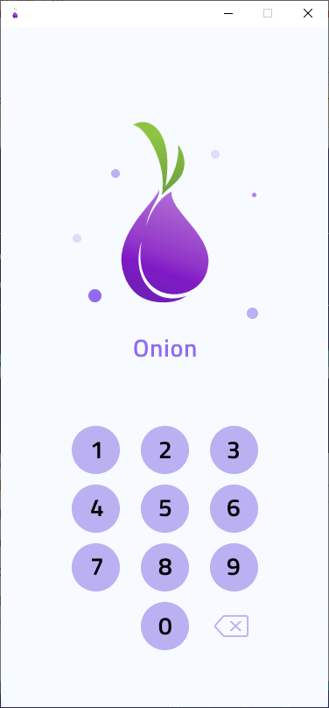
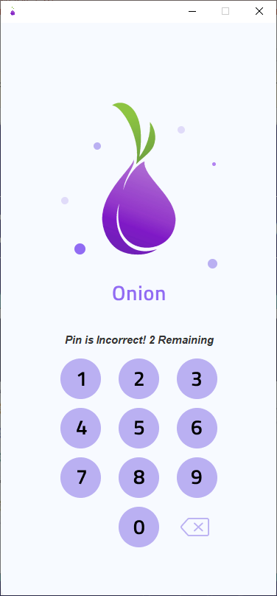

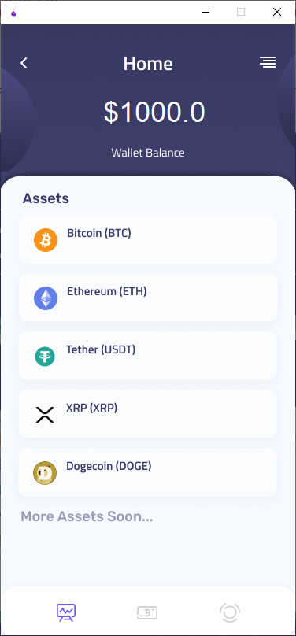

PRODUCT DEMO - LOGIN
Notes:
Login Page
The login page is the first security layer, before accessing your funds or any feature, we first have the PIN verification

Slide 14
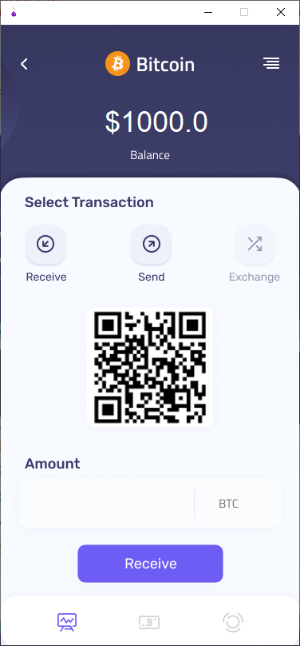
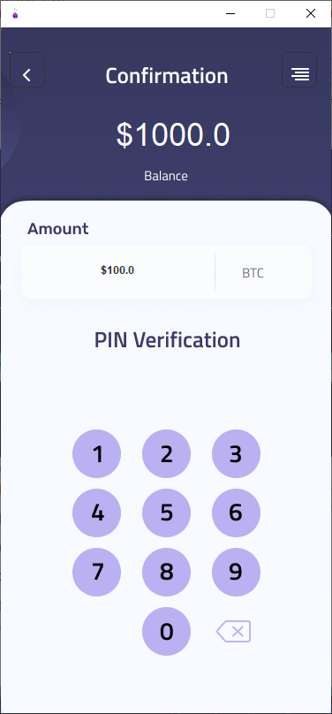
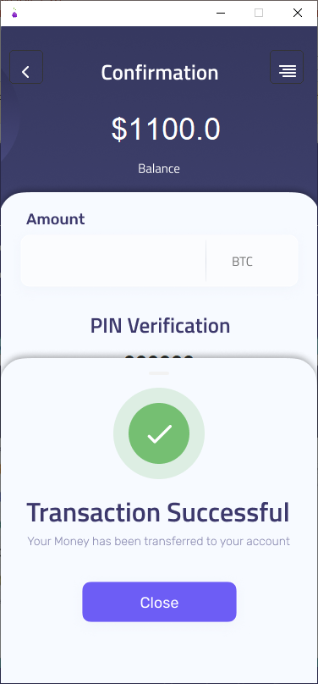
PRODUCT DEMO - RECEIVE
Notes:
Login Page
The login page is the first security layer, before accessing your funds or any feature, we first have the PIN verification

Slide 15
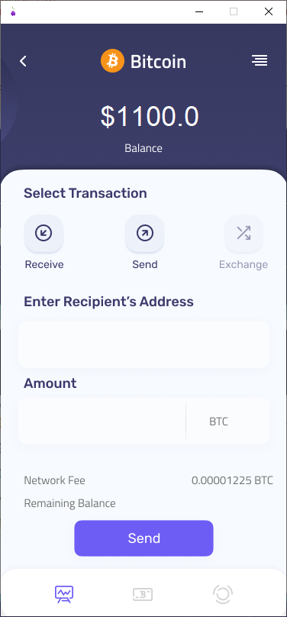
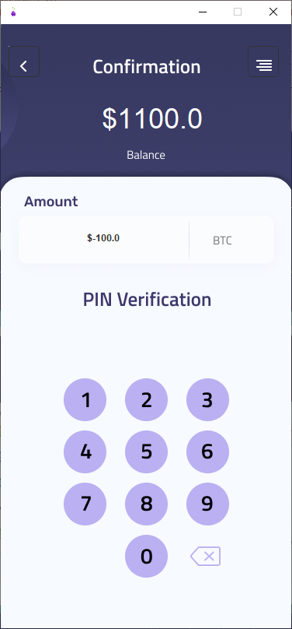
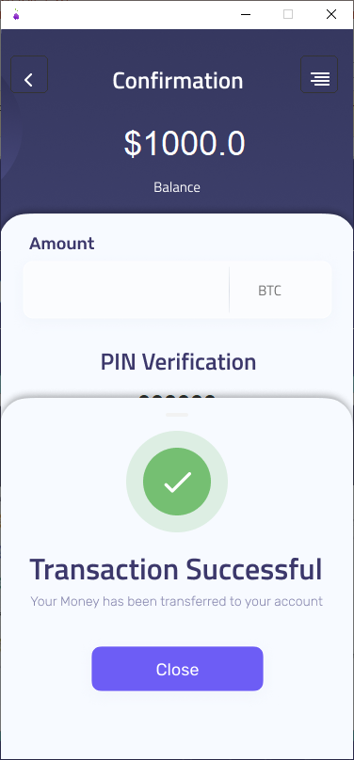
PRODUCT DEMO - SEND
Notes:
Login Page
The login page is the first security layer, before accessing your funds or any feature, we first have the PIN verification

Slide 16
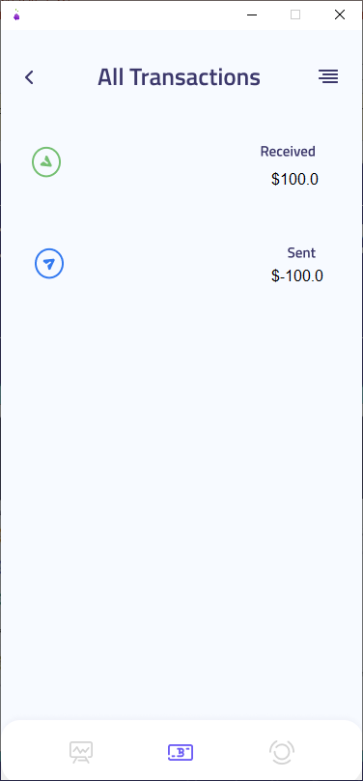
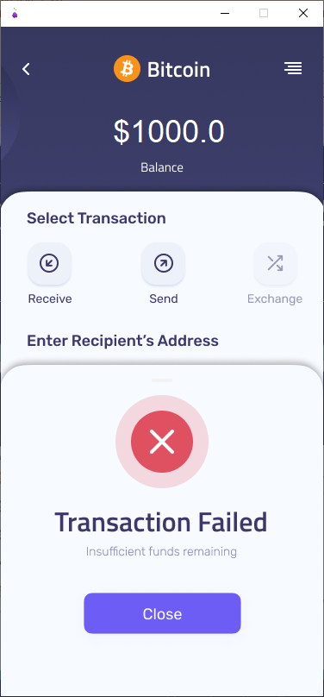
PRODUCT DEMO – TRANSACT HISTORY & MORE
Notes:
Login Page
The login page is the first security layer, before accessing your funds or any feature, we first have the PIN verification

